Slide 1
Drawing with Functions
Splash 2019 A13166
Margaret Zheng, Gloria Lin

Slide 2
Hi
(and let’s pull up www.desmos.com if you haven’t done so!)

Slide 3
What can we draw with Desmos?
Mathematical objects
Things you can use them to draw
Points
Lines
Shapes
Animations
…
If you want to learn more:
https://learn.desmos.com/graphing

Slide 4
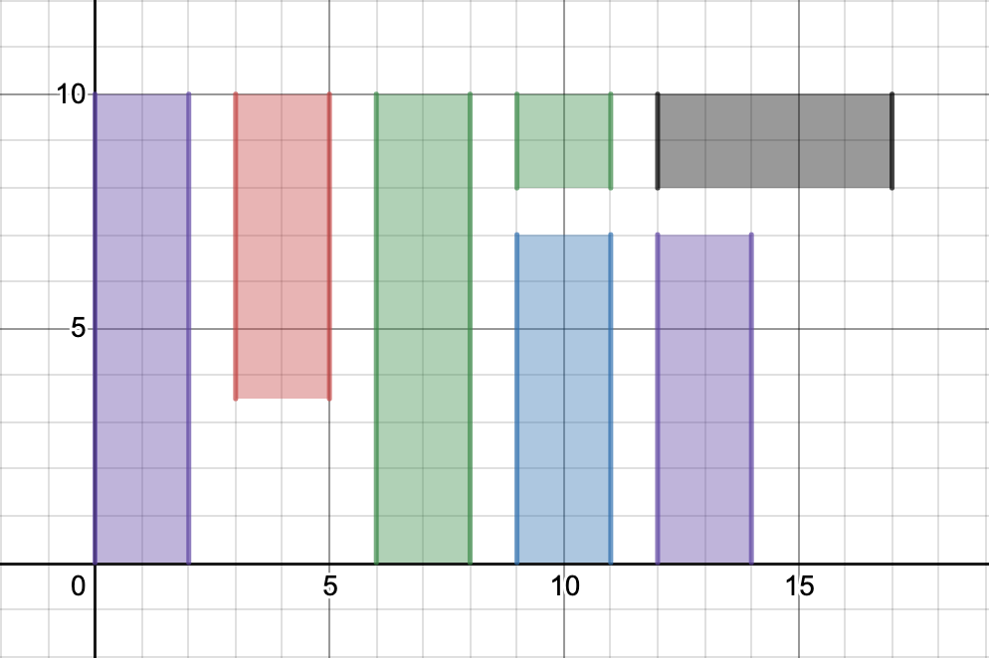
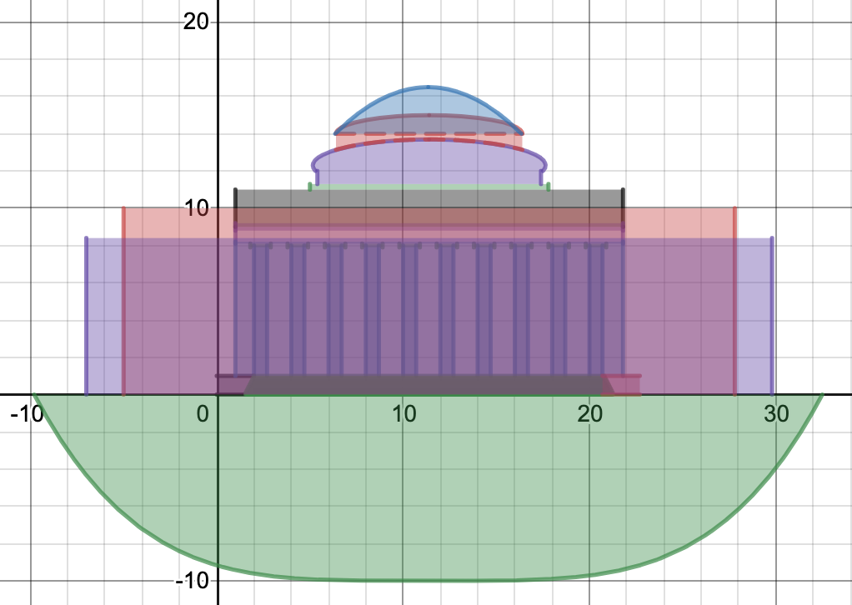
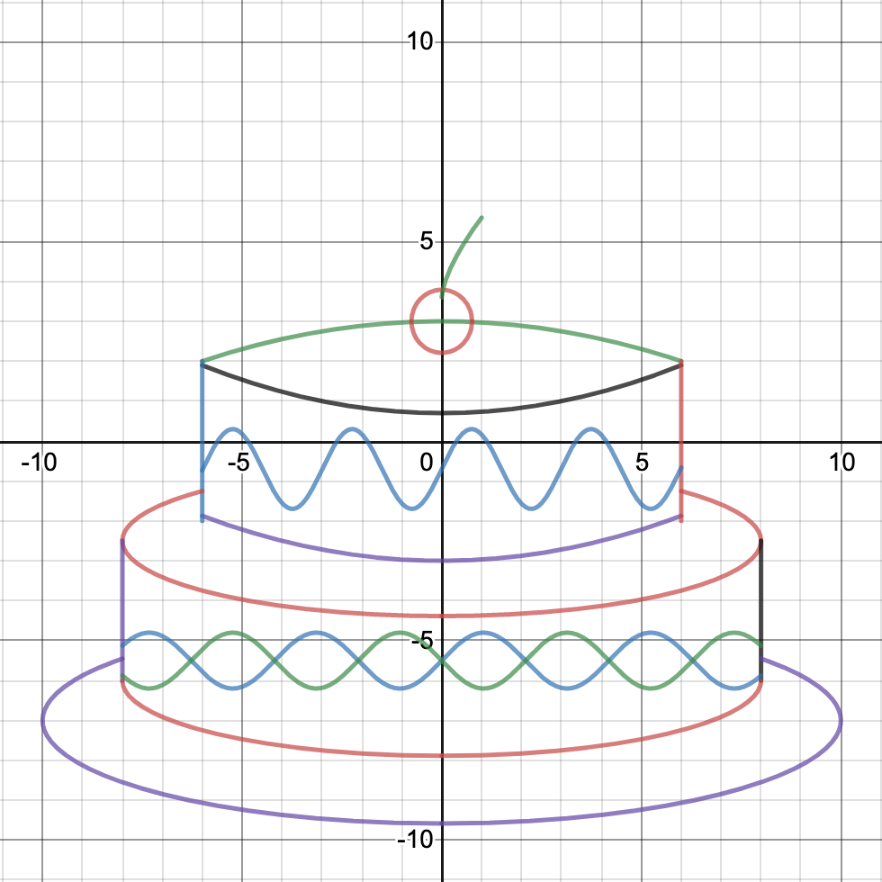
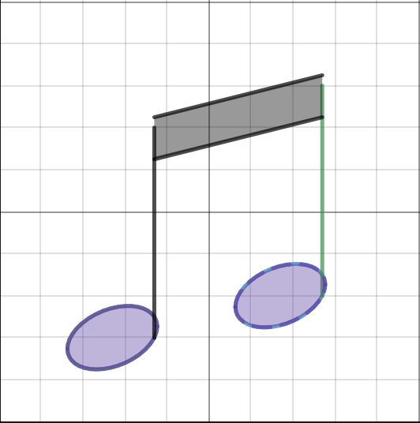

Slide 5
Exercise 0: Gimme a cRaZy FuNcTiOn!
Draw some functions.
Whatever functions.
As crazy as you want them to be!

Slide 6
So That’s Kinda Cool
But it’d be cooler if we know these…

Slide 7
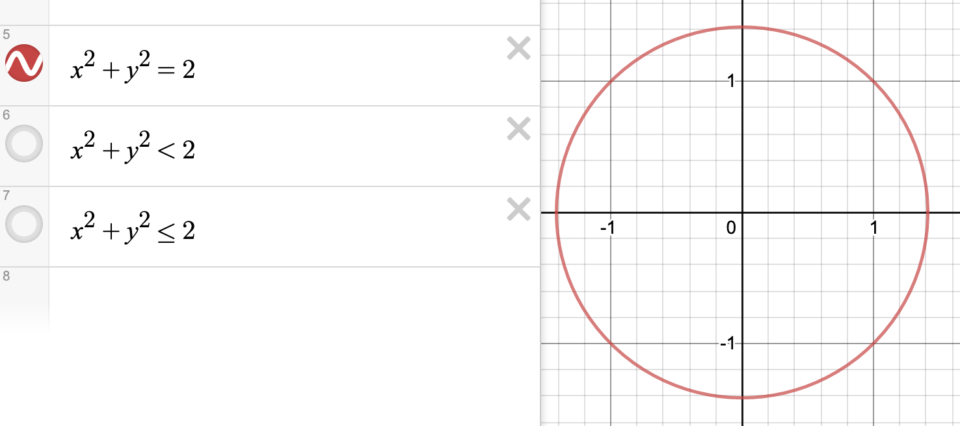
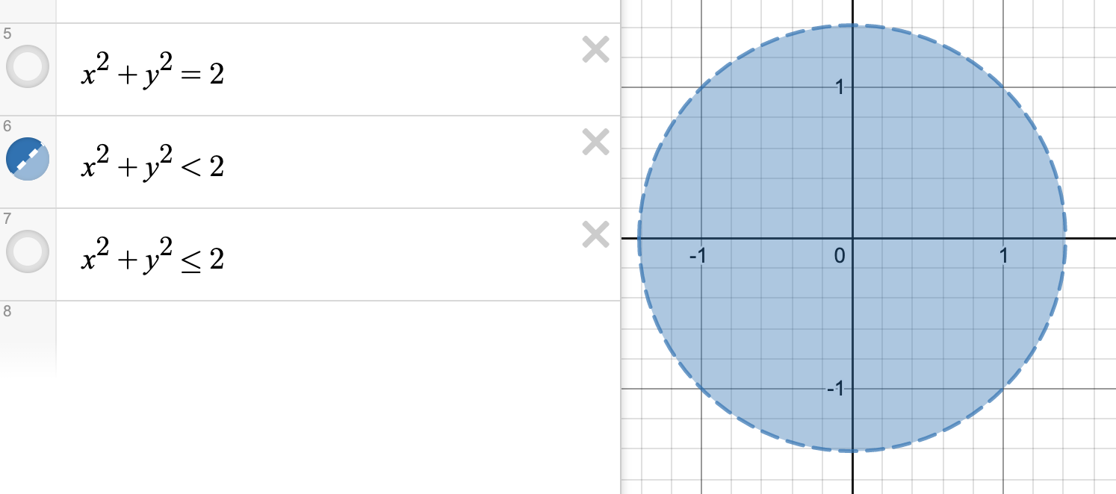
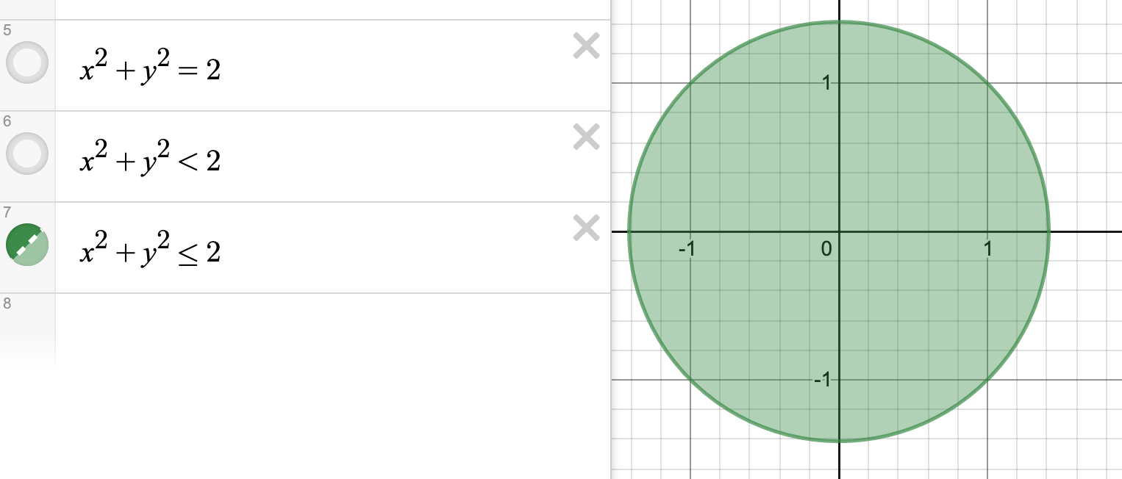
Inequalities
What it does: Shading
Where it is: within an expression
Extra Tips:
1. Inequalities make solid things!
2. Desmos only gives you several colors, but you can use inequality shading (by duplicating) to make different colors!

Slide 8
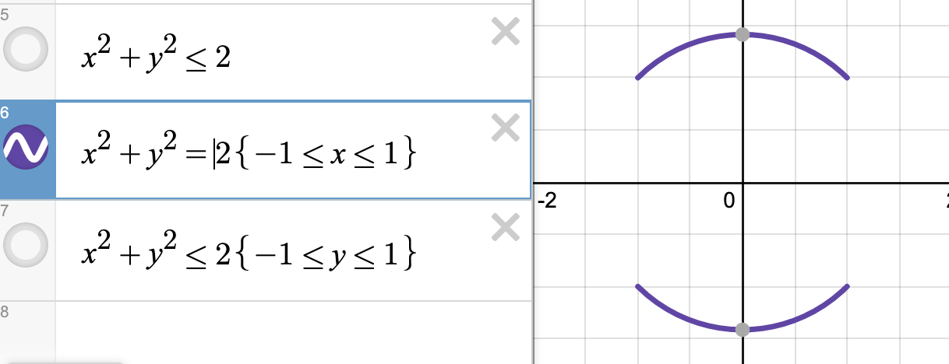
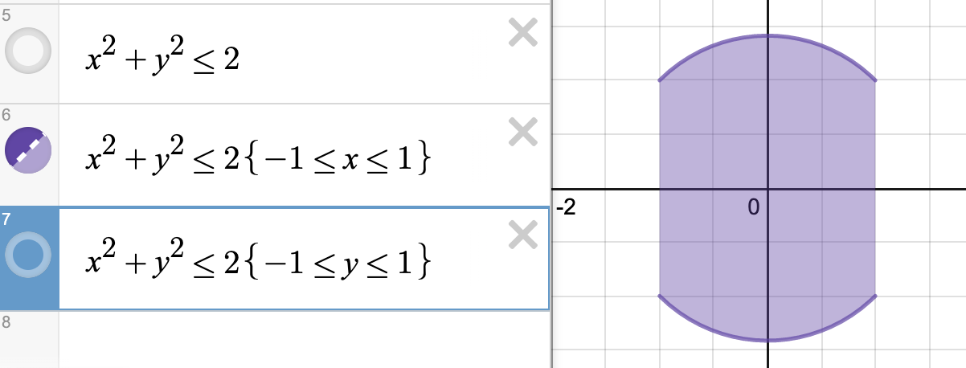
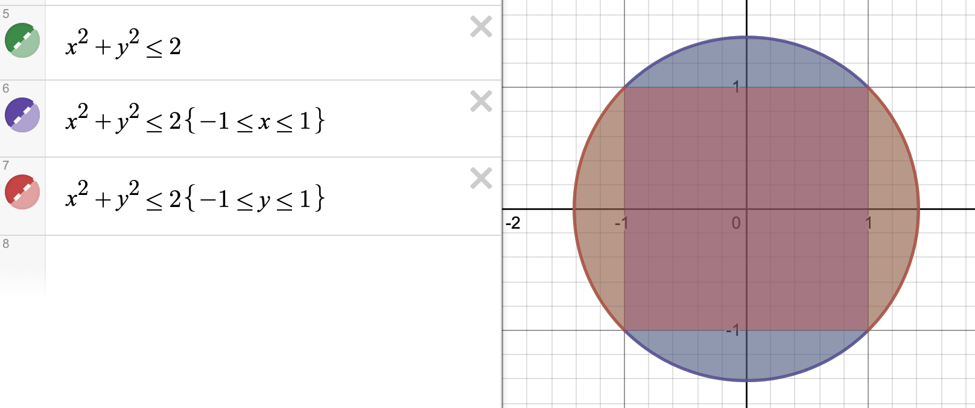
Ranges
What it does: cut off a function to the size you need
Where it is: {in a bracket outside the expression}
Extra Tips:
1. Ranges work with equations AND inequalities well.
2. You can set x or y ranges. But don’t try to do x-and-y ranges yet (i.e. putting everything in between the {inequalities}. Because Desmos sometimes give you a warning…

Slide 9
Exercise 1: Draw a filled triangle
Draw a triangle.
Anywhere on your canvas.
Isosceles or scalene, obtuse or acute, any triangle welcomed!
Then fill it!

Slide 10
Demo 1: Draw a filled triangle
Step 1: draw any 3 non-parallel lines.
Step 2: Set your ranges – find your intercepts!
Step 3: Try shading (get the direction right)
Step 4: Set shading range constraints
Step 5: DONE!
Demo
A interesting master Demo (unfilled)

Slide 11
Awesome
But what if we wanted to move the triangle?

Slide 12
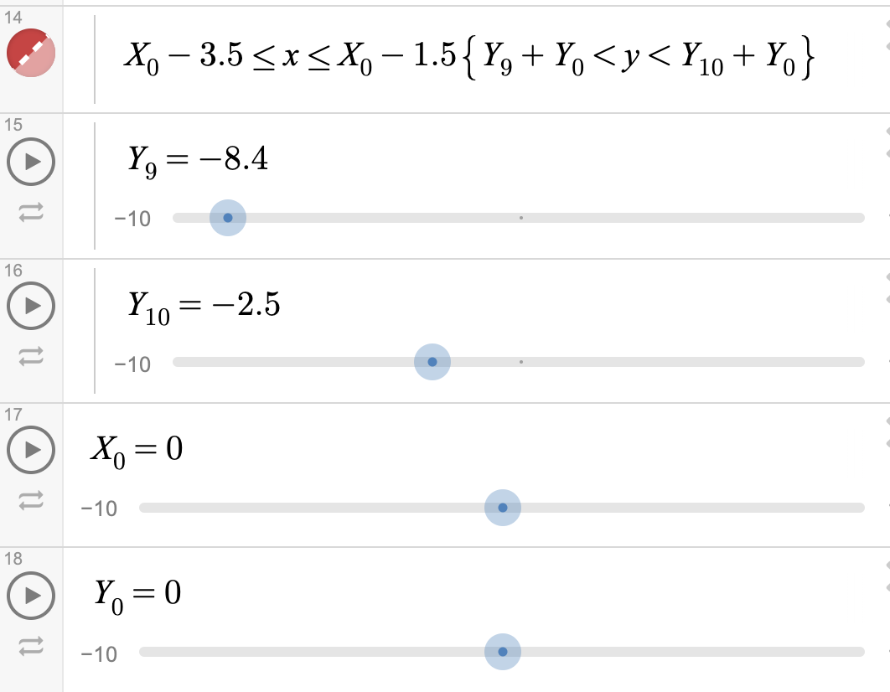
Sliders
What they do: allow us to make changes to functions without having to change the function itself
Where they are: set as new expressions
How to: replace x and y’s with (x-X₀) and (y-Y₀)
you can add as many sliders as you want!
Sliders let you do “animation”!
Which ones are sliders?
Demo: Moving Blocks

Slide 13
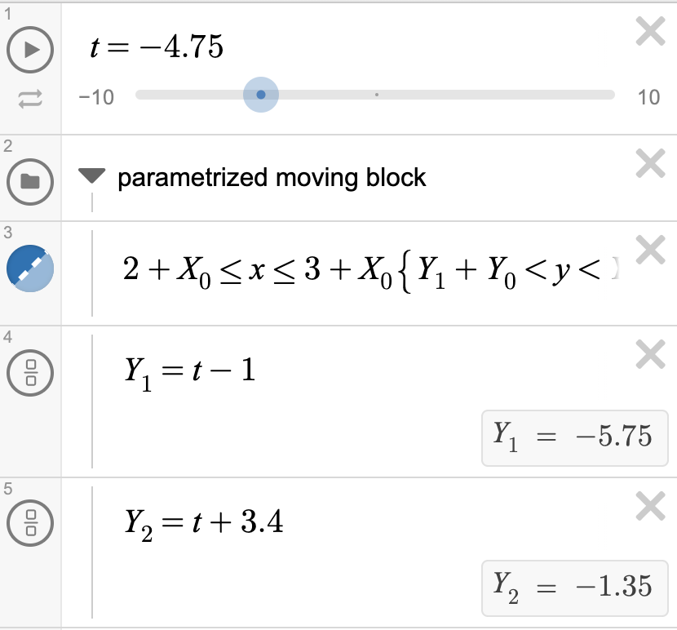
Parameters
What they do: sliders 2.0! Allow us to make changes to functions without having to change the function itself
Where they are: set as new expressions
you can add as many parameters as you want!
Demo: Moving blocks
Notes:
.

Slide 14
Sliders & Parameters
Why Sliders?
Why Parameters?
Sliders are more convenient and easier to understand if you ONLY need translational motion (i.e. move up and down) .
1. If you know you may want to shift the entire graph later, make a general X and Y slider (one that applies to all graphs). When applying sliders, make sure to apply them EVERY SINGLE TIME you see x and y!
2. Set your general X and Y slider to 0 and don’t change it until you are finished with the graph!
Parameters let you do way more than translational motion! Try it out!
Parameters make animation much easier!

Slide 15
Exercise 2: Move that triangle!
I want to move my triangle!
I also want to move it just by 2-3 clicks!
Bonus: can you make a constantly moving triangle?
Be creative!
Hint: can you think of a path?
A link to a complete, but not moving triangle - https://www.desmos.com/calculator/8xbksl9e0t

Slide 16
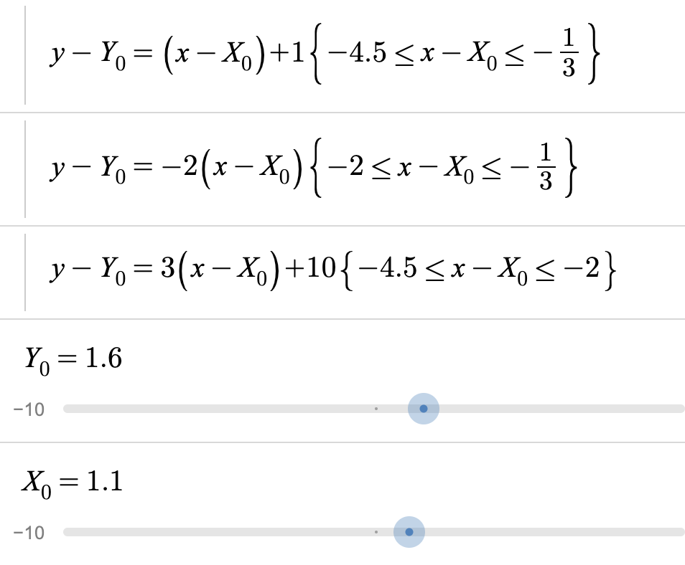
Demo 2: Move that triangle!
Step 1: Make 1 slider for x and 1 parameter for y (like X₀ and Y₀).
Step 2: For every x and y you see, replace with (x-X₀) and (y-Y₀).
Step 2.1: You could do this with parameters too – set a parameter t (or whatever other letter), then set X₀ and Y₀ to be some t-related value.
Step 3. Hit the play button on the left (if you did it with parameters, you just need to hit once!)
Demo

Slide 17
That’s all great
But what if I wanted more than one object (easily)?

Slide 18
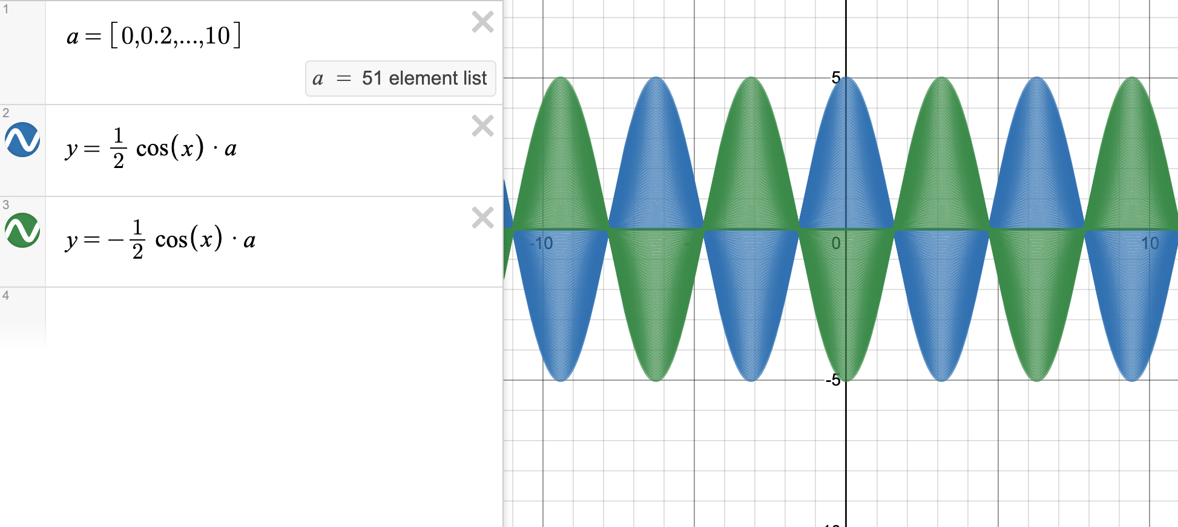
Lists
What they do: create a list of elements (so that you can draw a function many times without typing them out every time!)
Where they are: set as [new expressions] , in square brackets
Desmos is smart enough to generate an arithmetic sequence with the 2 or 3 numbers you feed it!

Slide 19
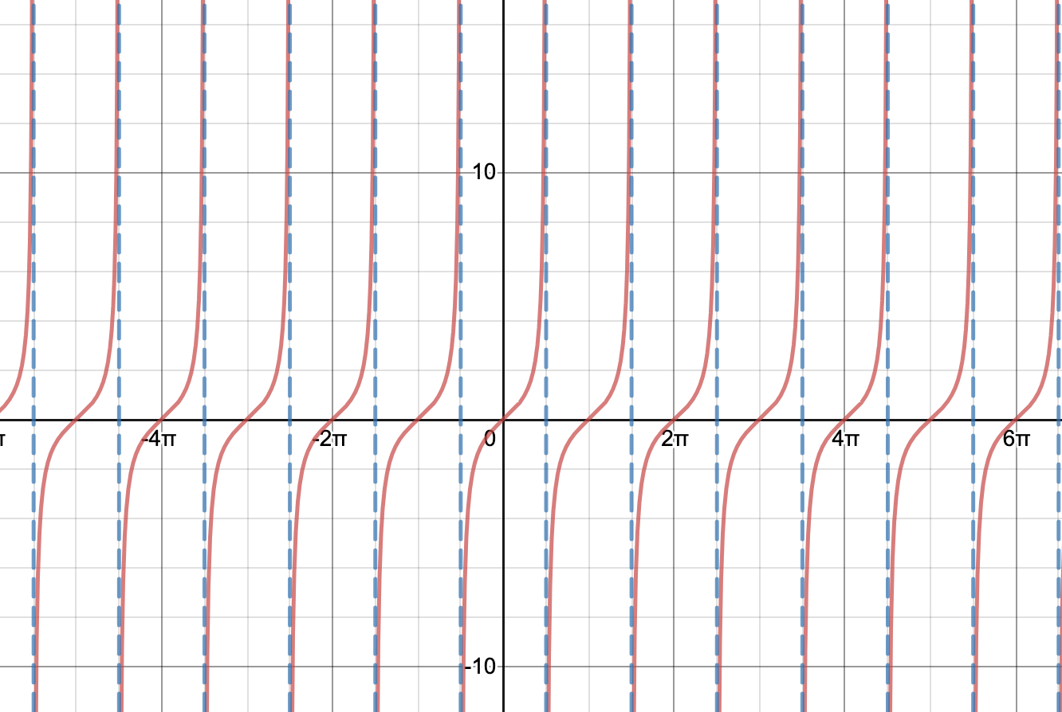
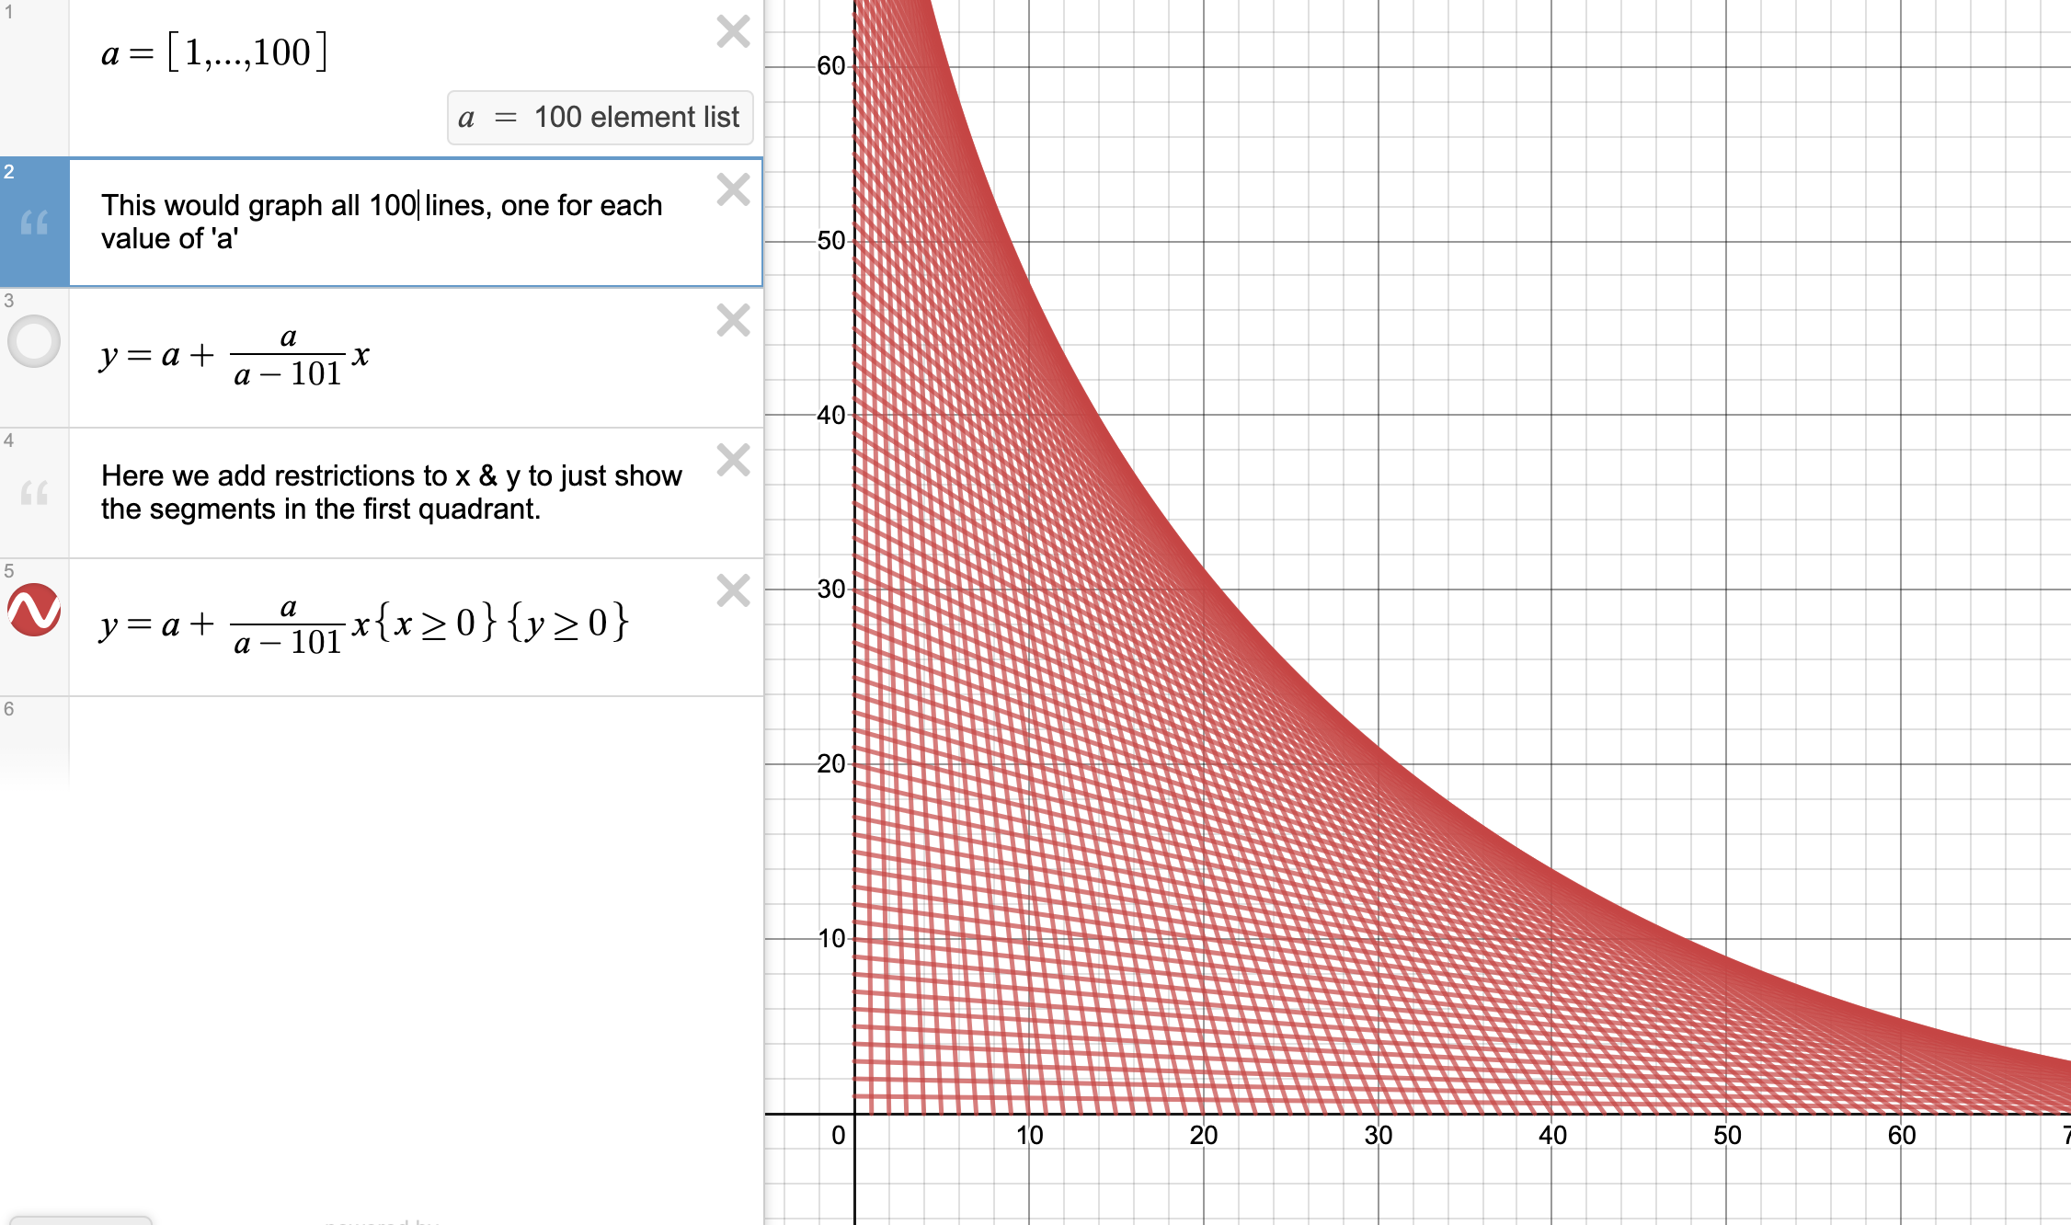
And you can use lists to make…

Slide 20
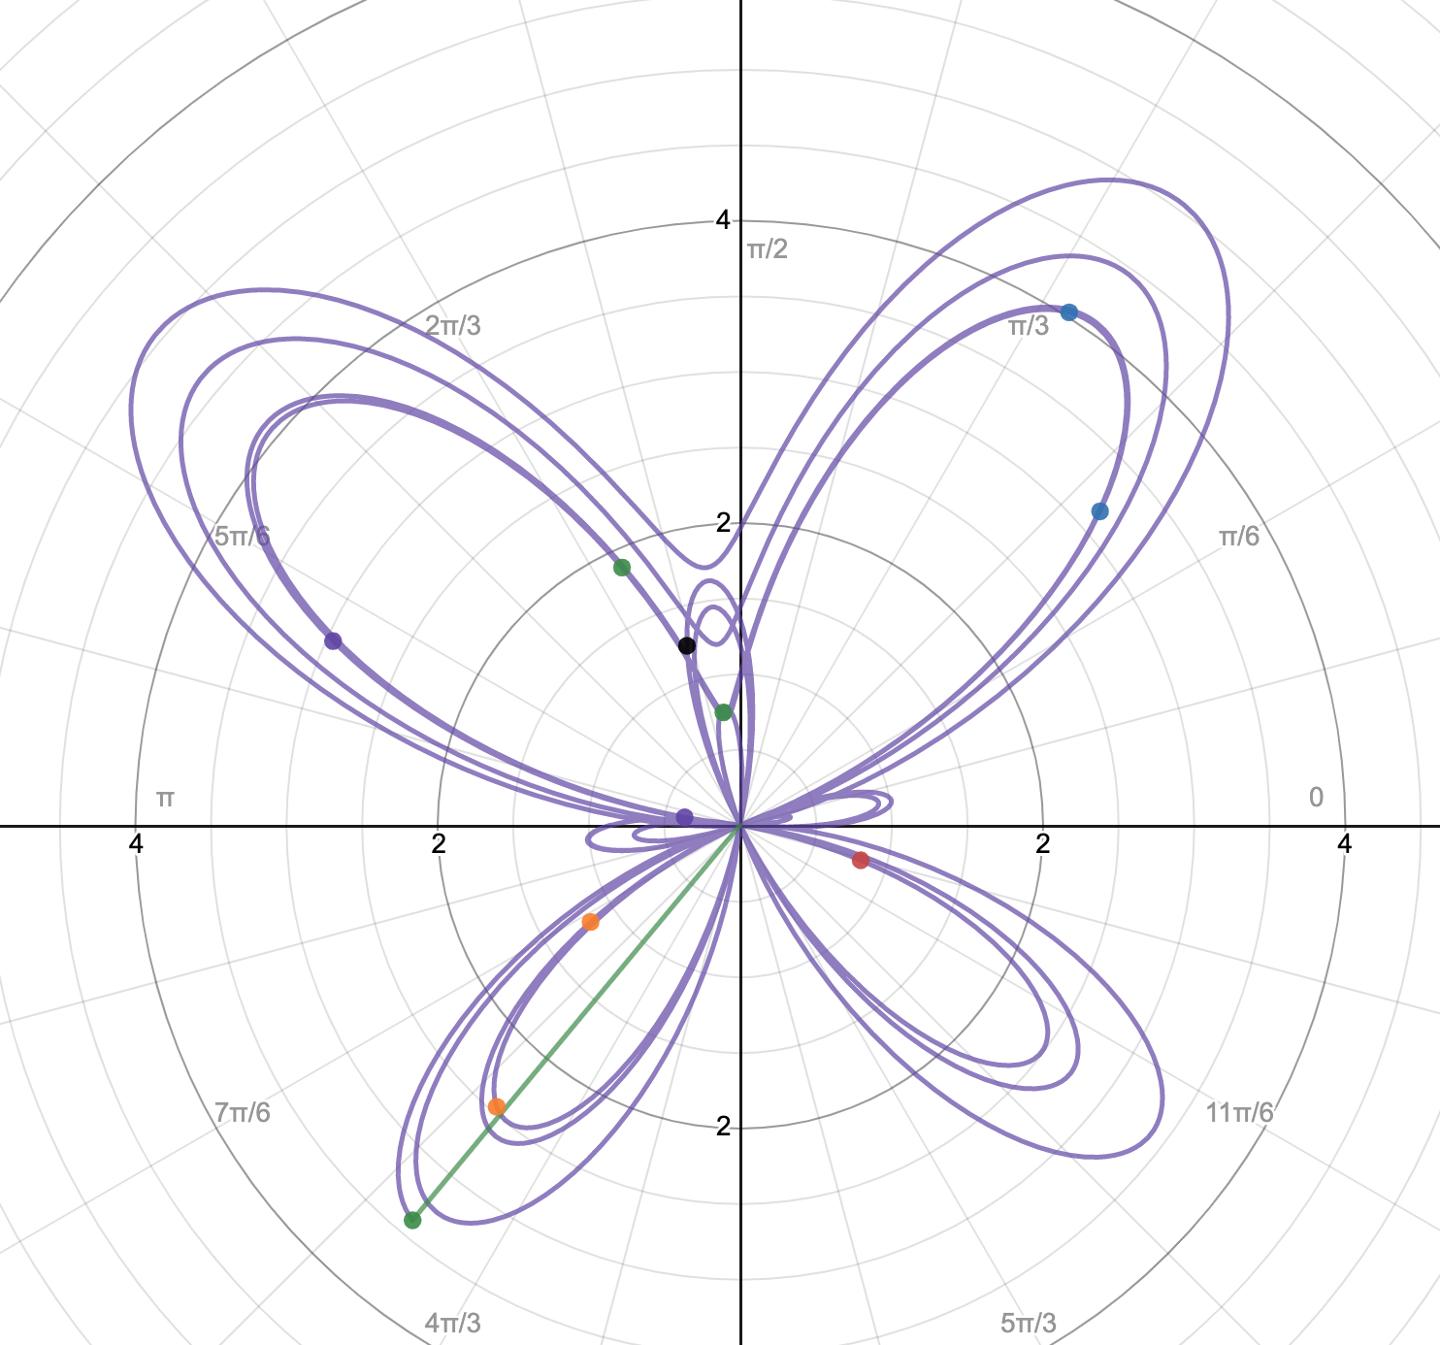
Polar coordinates
They make cool round shapes!
type: r = ……
r = constant gives you a circle
r = $θ$ gives you a spiral
r = $sin⁡(aθ)$ (a is a constant) give you roses
Try combinations of trig functions!

Slide 21
Recap!
Inequalities
Ranges
Sliders
Parameters
Lists
Polar coordinates

Slide 22
General Tips for Creation
Don’t be afraid to change your coefficients/do transformation!
Block-like things = think rectangles (x or y between 2 values).
Round things = think circles/ellipses!
When in doubt about ranges, click on intercepts to find out their values!

Slide 23
Art time!
Let me know if you have any questions!

Slide 24
Hope you had a great time!
Keep on the mathy art ☺

